Slide 1
Do we actually need both Speculative and non-speculative counter ?
We don’t need Speculative counter, only non-speculative is enough for counting loop trip count

Slide 2
Where speculative iteration counter is used?
Speculative iteration counter is used to override the branch predictor's misprediction
Phase 1: Branch Prediction
Check for PC in LTB
If PC found in LTB
Check Confidence bit
TC == SIC
Check Confidence bit
Yes
TC == SIC
Yes
No
No
No
Yes
PC Not found in LTB
Predict branch not taken
(loop exit)
SIC ++
Predict branch not taken
(loop exit)
Branch Predictor make decision
If they match and the predictor is confident, it safely overrides the baseline branch predictor by forcing a "Not-Taken" prediction to correctly terminate the loop

Slide 3
New loop termination buffer
PC | TC | SC | NSC | Conf
PC | TBA | TC | NSC | Pf_C
TC: Trip counter
SC: Speculative Iteration counter
NSC : Non-Speculative iteration counter
Conf : Confidence bit
TBA : Target Branch address
Pf_C : Count prefetch issued for a PC

Slide 4
Test Cases

Slide 5
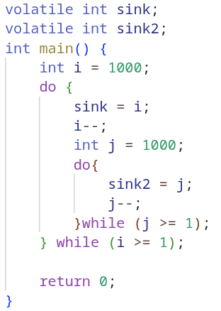
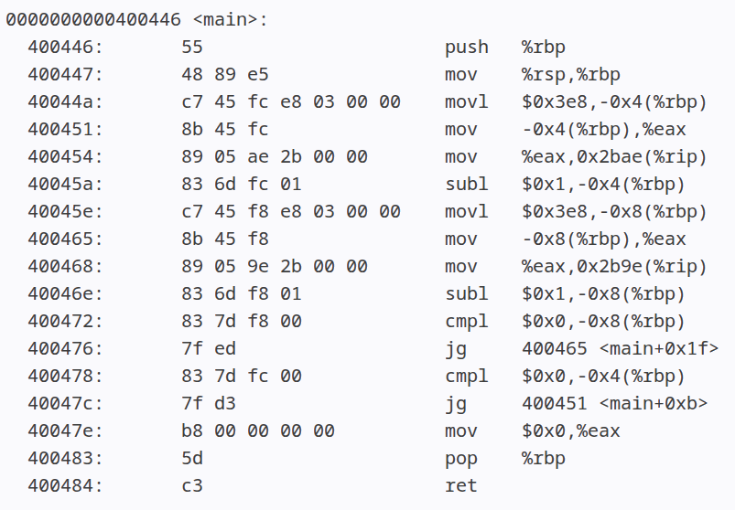
Loop iteration count with Nested loop
Testcase 2

Slide 6
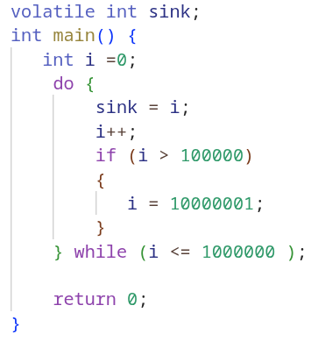
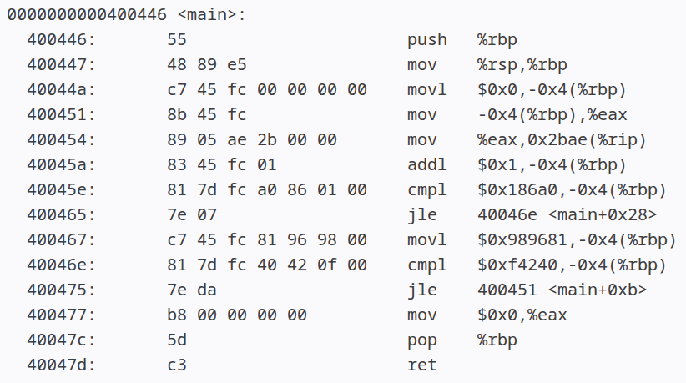
Loop iteration count, loop with if break condition without
Testcase 3

Slide 7
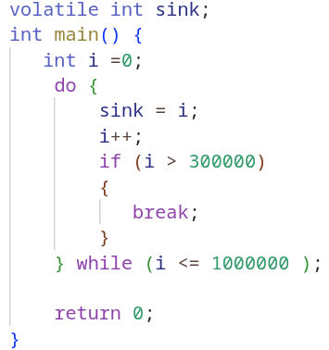
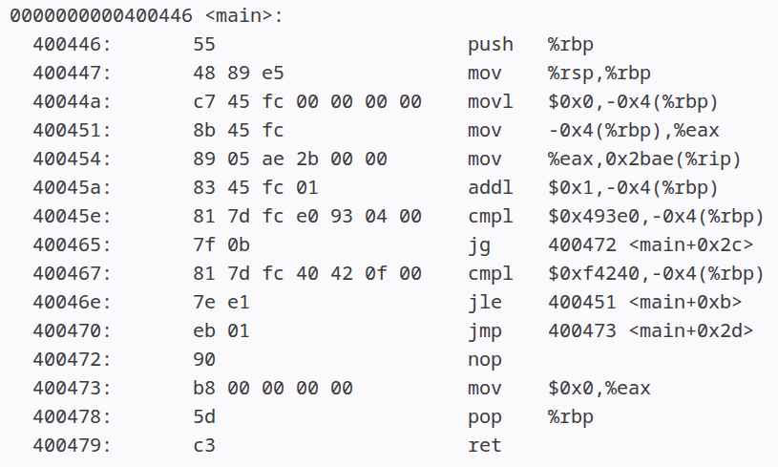
Loop iteration count, loop with if condition
Testcase 4

Slide 8
How do we capture this behavior ?
Testcase 4
The iteration count of loop is affected because of "IF condition" with break statement
To capture this behavior, we need to find in which loop does this "IF condition" present because we could have multiple loops in our program
There are two trends of "IF condition" statement first when it terminate a loop and when it does not terminate a loop

Slide 9
How do we capture this behavior ?
Testcase 4
When loop get terminated
PC: Loop Start
PC: IF Cond. Check
Taken only when IF condition is satisfied
PC: Loop End
PC: IF cond. target
We will search above pattern in loop buffer and then update the trip count of loop

Slide 10
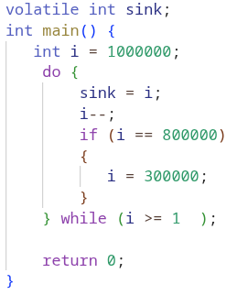
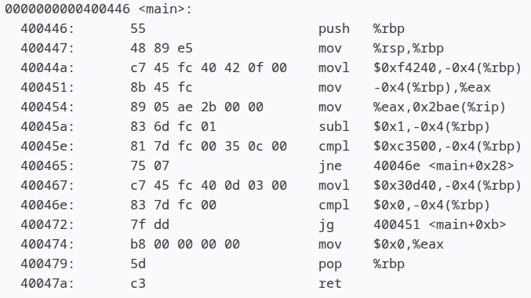
How do we capture this behavior ?
Testcase 5
2. When loop does not get terminated
PC: Loop Start
PC: IF Cond. Check
PC: IF cond. target
PC: Loop End
We will search above pattern in loop buffer

Slide 11
How do we know which branch path is taken for trip count ?
To learn about the path taken by branch we need to make some changes in our loop buffer
PC | TBA | TC | NSC | IEB | ITA | Pf_C
PC : Program Counter
TBA : Target branch address
TC : Trip count
NSC: Non-speculative iteration counter
IEB : IF-Else Branch address
ITA : IF-Else traget address
Pf_C: Prefetch counter

Slide 12
How do we know which branch path is taken for trip count ?
PC | TBA | TC | NSC | IEB | ITA | Pf_C
40046e | 400451 | 300000 | 270919 | 400465 | 400472 | 0

Slide 13
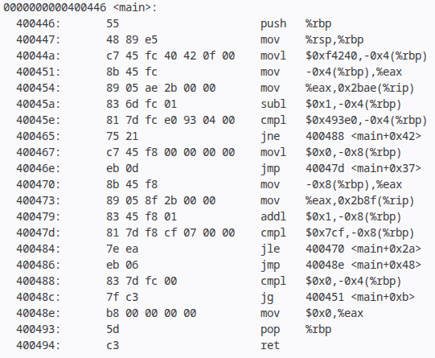
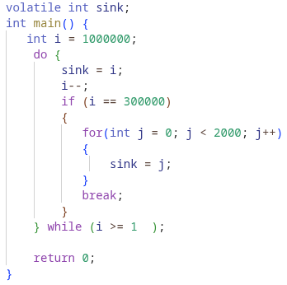
Testcase 6
PC | TBA | TC | NSC | IEB | ITA | Pf_C
40048c | 400451 | 699999 | 440633 | 400465 | 400488 | 0
400484 | 400470 | 2001 | 0 | 0 | 0 | 0

Slide 14
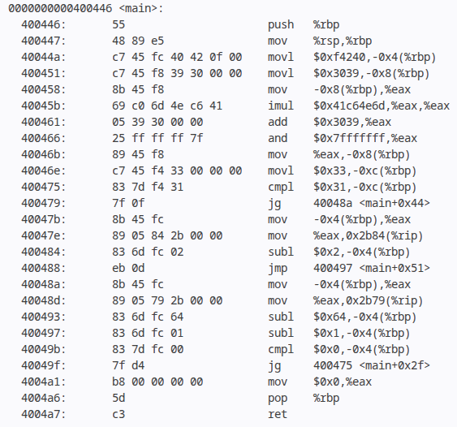
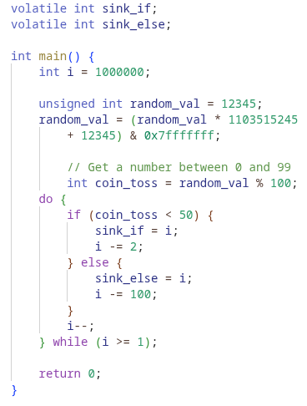
Testcase 7

Slide 15
What is the accuracy of predicted loop iteration count ?

Slide 16
Simulation parameter
Processor | Intel alder lake
Core | Out-of-order, bimodal branch predictor, 4 GHz with 6-issue width, 4-retire width, 352-entry ROB
TLBs | L1 iTLB/dTLB: 64 entries, 4-way, 1 cycle STLB: 1536 entries, 12-way, 8 cycles
L1I | 64 KB, 8-way, 4 cycles, 8 MSHRs, LRU
L1D | 48 KB, 12-way, 5 cycles, 16 MSHRs, LRU
L2 | 2 MB, 16-way, 15 cycles, 32 MSHRs
LLC | 3 MB, 16-way, 35 cycles, 64 MSHRs
Cache hierarchy | Non-inclusive
DRAM | Controller: One channel/4-cores, 6400 MTPS, write watermark: 7/8th, Chip: 4 KB row-buffer, open page, tRP: 12.5 ns, tRCD: 12.5 ns, tCAS: 12.5 ns
Notes:
Processor used is intel alder lake with L1d __ , L2 512kb , LLC 2mb

Slide 17
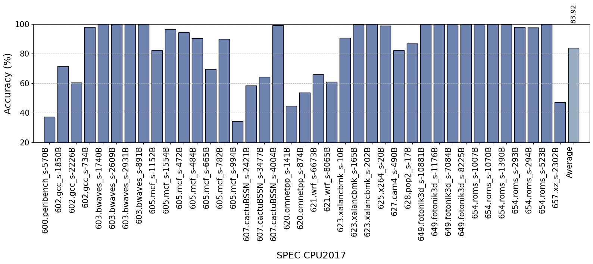
Loop iteration count accuracy for SPEC CPU2017 workload
Data prefetcher
L1D: Berti, L2: IP Stride
Replacement policy
L2: SRRIP, LLC: Mockingjay
We achieve 90% or more accuracy for half of the traces but the overall accuracy across workload is ~84%

Slide 18
What are we missing?
Loop PC
R
R
R
A
B
B
A
B
A
D
E
G
G
D
G
D
E
E
C
F
C
C
F
F
RBG : 20
H
I
H
H
I
I
RAEF : 10
J
J
J
RADCI : 40
RADCHJ : 20

Slide 19
New design of loop iteration count buffer
Program Counter | Target Address | Iteration Count | Non-Speculative Counter | Prefetch Counter
Branch History | Iteration count

Slide 20
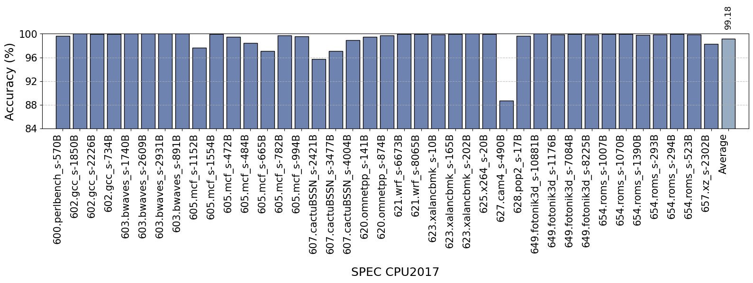
Loop iteration count accuracy for SPEC workload
Data prefetcher
L1D: Berti, L2: IP Stride
Replacement policy
L2: SRRIP, LLC: Mockingjay
We achieve ~99% accuracy in SPEC CPU17 workload

Slide 21
Thank You

